Slide 1
Triple Integrals (rectangular)

Slide 2

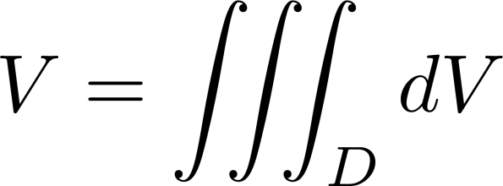
Volume

Slide 3

Mass from Density

Slide 4
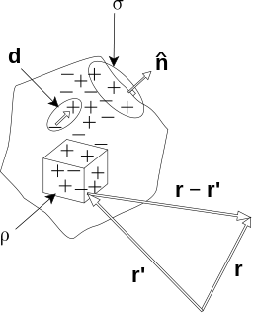

Charge From Density

Slide 5
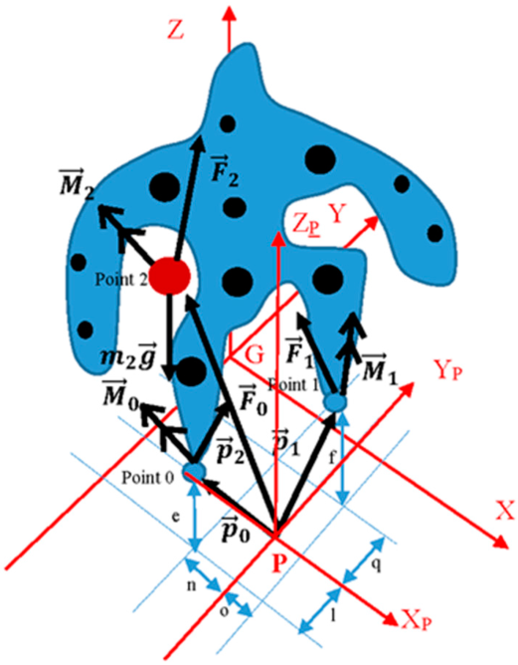

Center of Mass

Slide 6

Moment of Inertia

Slide 7
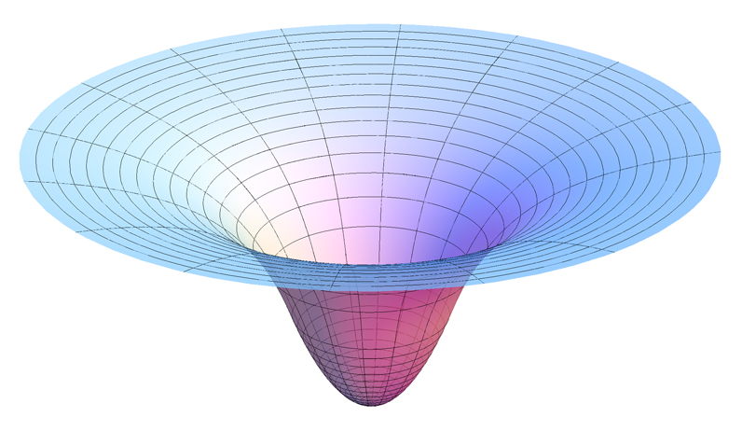

Gravitational Potential

Slide 8
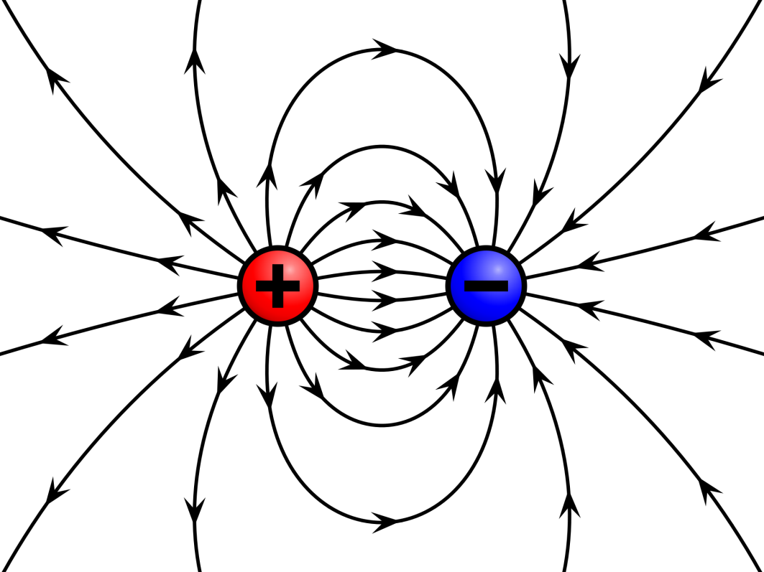

Electric Field

Slide 9
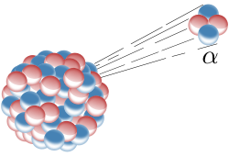

Higher Order Integrals

